Slide 1
Food Fuels Learning
Annual Update
August 06, 2019
Notes:
Good evening! My name is Laura Robinson, and I am a board member of the Cumberland County Food Security Council and a member of the Food Fuels Learning Leadership Team.
Thank you for inviting us to present tonight. Please feel free to follow along in your handouts. Further information can be found on our website, foodfuelslearning.org and on our facebook page, facebook.com/foodfuelslearning.

Slide 2
What is Food Fuels Learning?
Notes:
Food Fuels Learning is an initiative started by a parent who saw children coming to school hungry. With the support of the Cumberland County Food Security Council and the Portland Public Schools superintendent, a community-driven effort was born.
The food fuels learning leadership team was assembled to help move this initiative forward.
To truly understand our school food system we needed to assess the school food system landscape before taking action.

Slide 3
Phase 1: Assessment
Notes:
This kicked off a year-long information gathering process, that we call phase 1.
A research team, and through this assessment process, the team met with over 200 members of the Portland, Maine community to discuss their greatest successes and struggles within the school food system.

Slide 4
Background
The Portland Public School (PPS) District provides education to 6,796 students in fifteen schools located in Cumberland County, Maine. More than half of these students (3,560) are eligible for free lunch,² which means that they live in a household at or below 130% of the poverty line. For example, if the student lives in a family of four people, the household will have an annual income between $0 and $31,980.³
² Maine Department of Education (2018a). % Free and Reduced School Lunch Report - ED 534 by District. Retrieved from https://neo.maine.gov/DOE/neo/Nutrition/Reports/NutritionReports.aspx?reportPath=ED534byDistrict.
³ Food and Nutrition Service, USDA (2017a). Child Nutrition Programs: Income Eligibility Guidelines. Retrieved from https://www.federalregister.gov/documents/2017/04/10/2017-07043/child-nutrition-programs-income-eligibility-guidelines.
Notes:
We knew that in the Portland Public School district more than half of students are eligible for free lunch.
But what we didn’t know was what was happening at individual schools across the district to address this need.

Slide 5
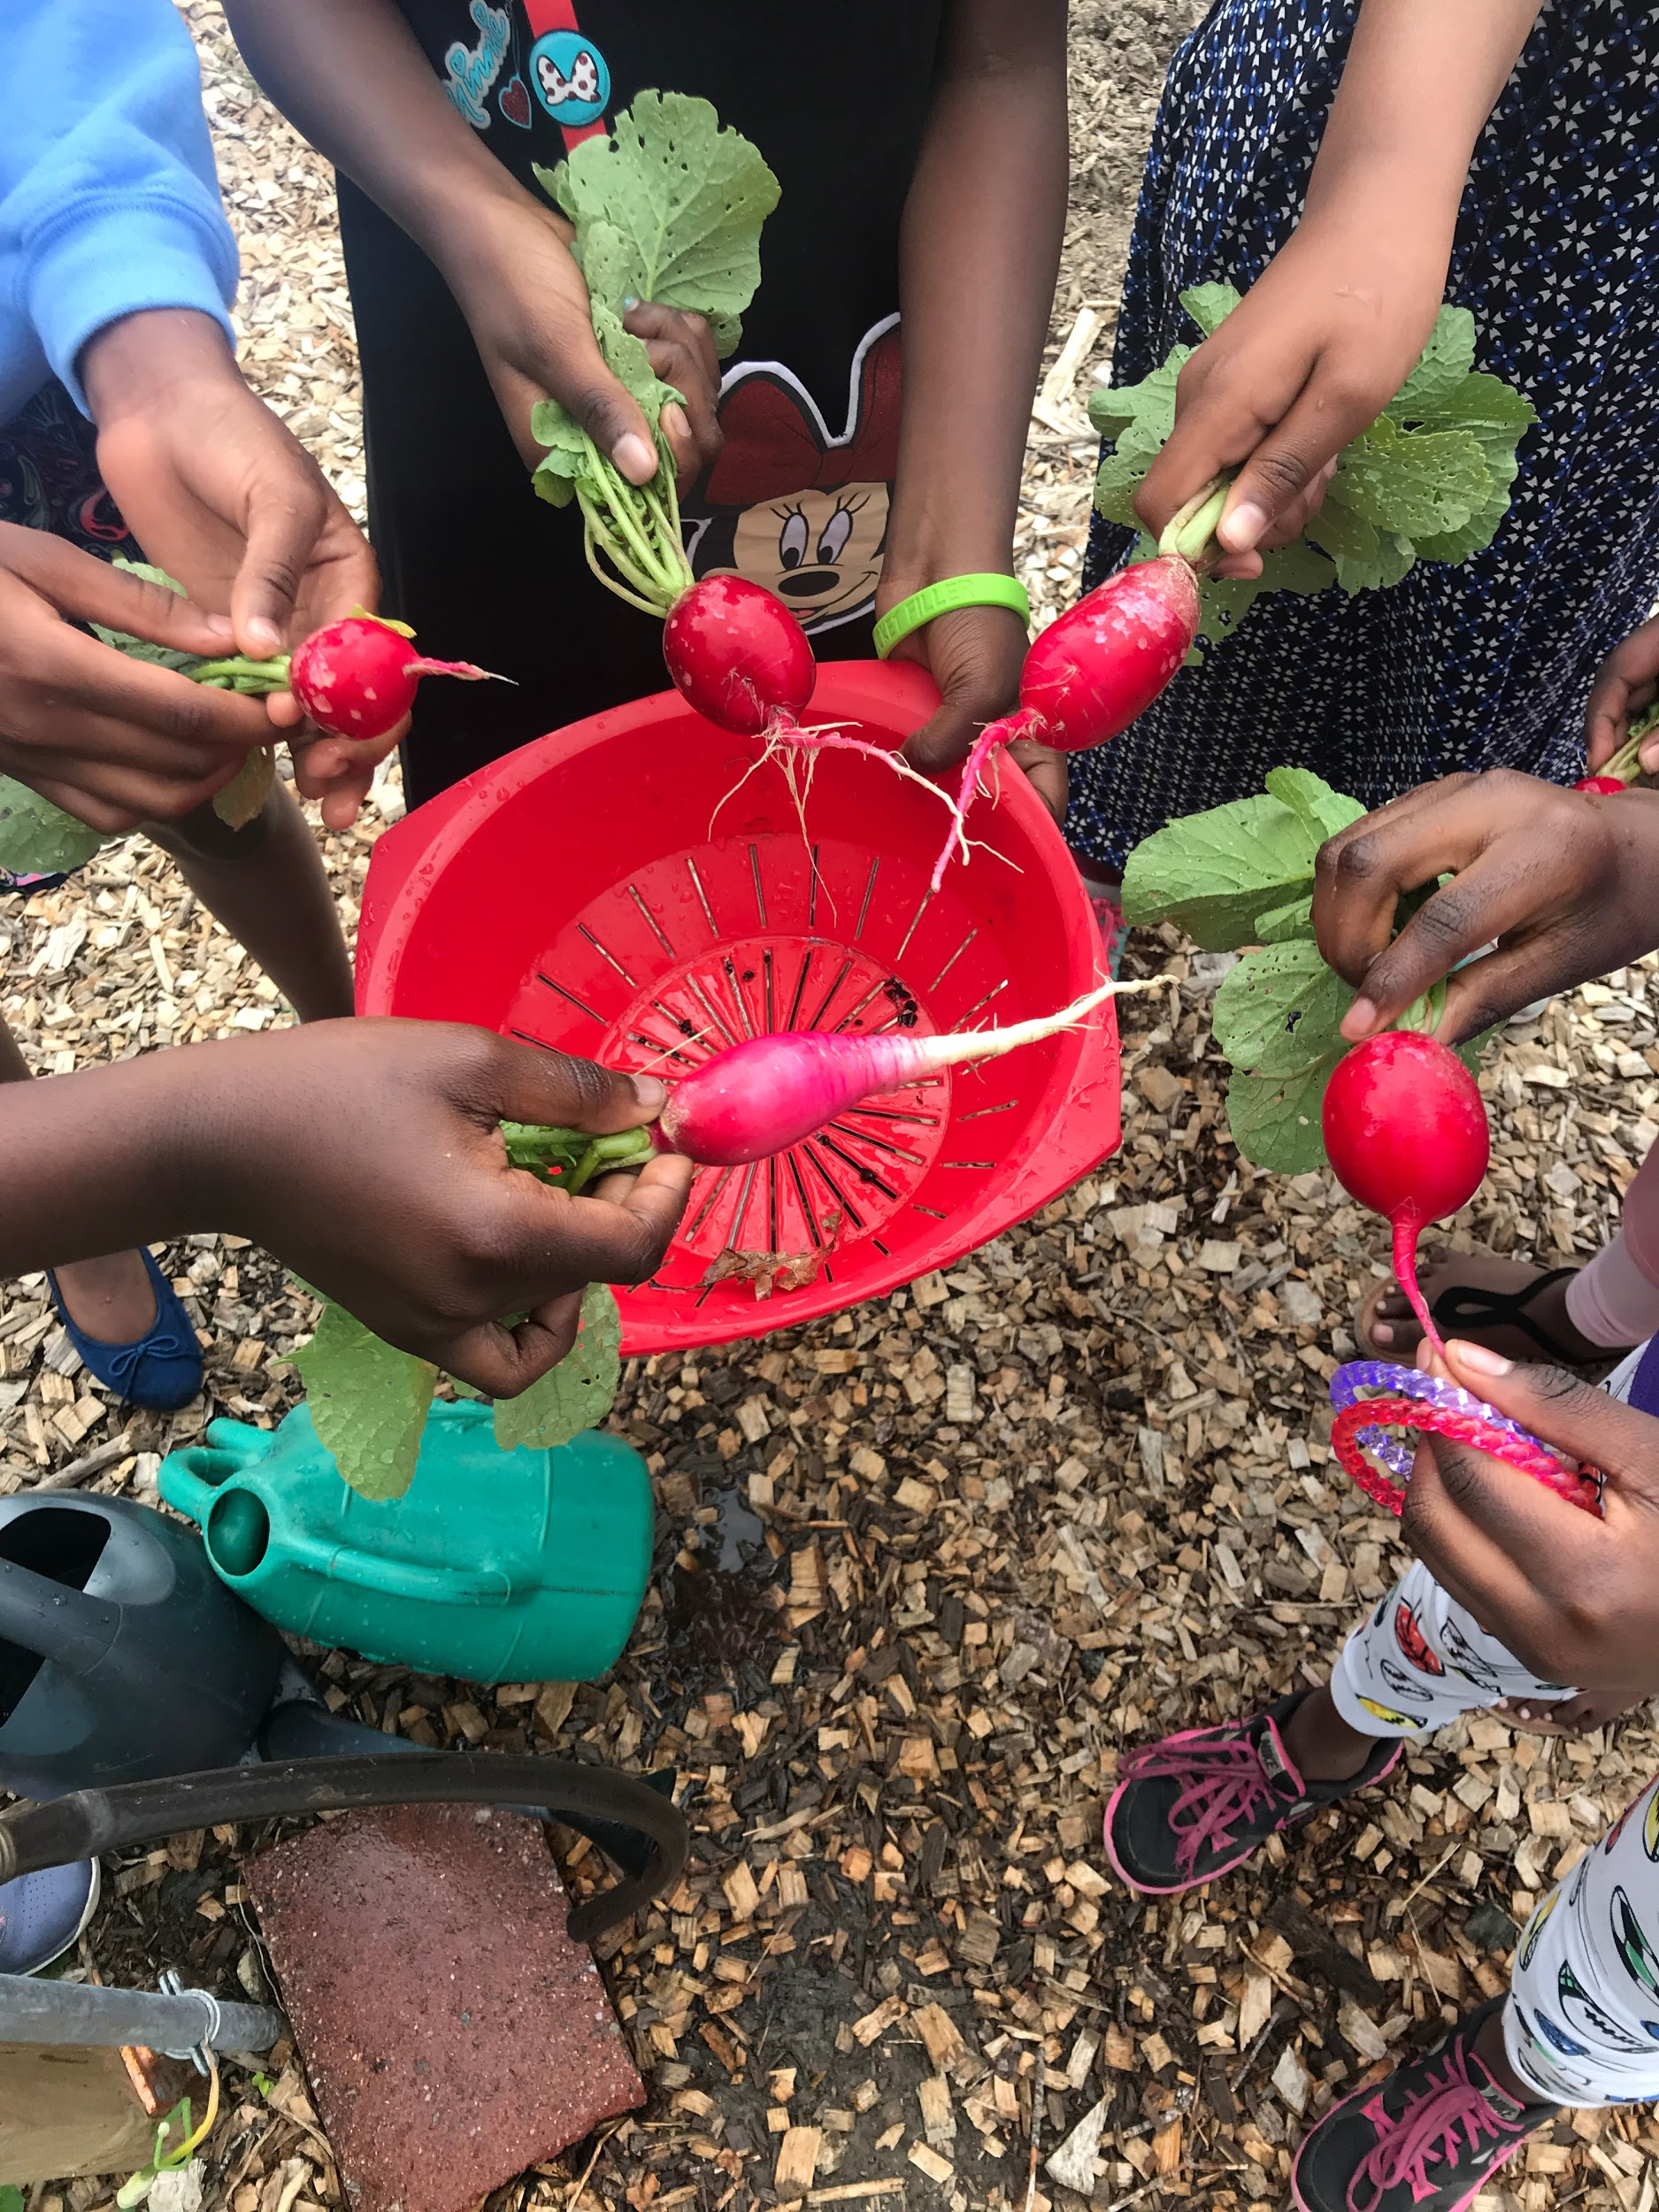
The Five Categories of the School Food System
Charitable food programs
Federal nutrition programs
School gardens
Nutrition education
Sustainable food practices
Notes:
So we focused our conversations in five areas that we identified as making up the Portland Public Schools food system:
Charitable food programs - things like school pantries, backpack programs, community meals, and fresh produce tables
Federal nutrition programs - school breakfast, school lunch, after school snack, and summer meals
School gardens - programs that teach students about where food comes from through experiential learning
Nutrition education - cooking classes, taste tests, programs that help motivate students to make healthy eating choices
Sustainable food practices - waste management (compost), share tables, local food procurement.

Slide 6
Goals
Food Fuels Learning began this work by articulating goals in each of the five categories of the school food system:
Charitable food programs - Ensure that all children at risk of food insecurity have access to adequate, culturally relevant, nutritious food both at school and to supplement their diet beyond school
Federal nutrition programs - Increase overall school meal participation and reduce challenges for food service staff
School gardens - Assist every school in developing and maintaining a successful school garden and school garden programming
Nutrition education - Provide schools with the tools they need to coordinate staff and organizational partners working to provide nutrition education to students
Sustainable practices - Support schools in creating procurement, waste management, and other practices that minimize their environmental impact and encourage their investment in local communities
In pursuit of these goals, Food Fuels Learning conducted a needs assessment to explore the presence and impact of activities within each of these five categories throughout the PPS district.
Notes:
We articulated goals in each of the five categories to help drive our research. These can also be found in your handout.

Slide 7
Timeline
Ongoing
Action Groups convened regularly to address report recommendations
March 2019
Food Fuels Learning Toolkit presented at the Universities Fighting World Hunger Summit at USM
April 2019
Food Fuels Learning In Action: Second Quarterly Meeting
August 2018
Present completed report to full School Board
October 2018
Food Fuels Learning Transitioning to Action Meeting
April 2019
Food Fuels Learning Toolkit presented at the Farm to Institution Summit at UMass Amherst
August 2019
Present Food Fuels Learning update to full School Board
February 2019
Food Fuels Learning In Action: First Quarterly Meeting
Notes:
-In August 2018, after many interviews, focus groups, and surveys, we published the Food Fuels Learning needs assessment report, and presented our findings to you.
-This report outlines what is happening in each of the Five Categories as well as a series of recommendations identified by community stakeholders about how to improve food security within each of these five categories.
-In assessing programs and making recommendations, we maintained our systems approach to encouraging institutionalized, sustainable change.

Slide 8
Phase 2: “In action”
Notes:
Upon completion of the assessment phase of food fuels learning, we transitioned to Phase 2, or the implementation phase of this project.
In this phase, we have invited the Portland community to participate in five action-oriented groups (based on our five categories of the school food system). These groups convene regularly and help to carry out the recommendations from the needs assessment.
In this phase we are prioritizing network building and helping different schools pollinate to share ideas and resources.
Additionally we hold quarterly report outs to share the work of the action groups with the community and superintendent . This is also our opportunity to make asks of the superintendent/broader school community.
It is our goal to have this process be as community lead as possible, in order to create sustainable and institutionalized structures within our school system.

Slide 9
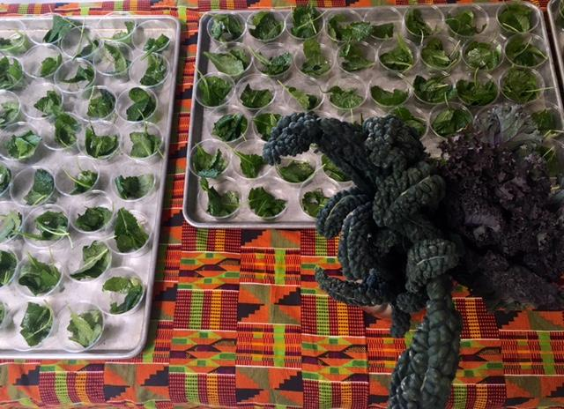
Food Fuels Learning Values Statement
We believe that food fuels learning and all students at Portland Public Schools have the right to nutritious food that allows them to attain their full potential.
Notes:
In order to help align our principles and guide our work, we developed the following values statement.

Slide 10
Food Fuels Learning Mission
Our mission is to build food security in schools through comprehensive research and community-based action.
Notes:
Through our shared values, we then articulated the following mission statement.

Slide 11
Process goals
Build food security
Community-led process
Prioritize sustainable systems change
Notes:
Our goals through this process are to 1) build food security, 2) encourage and facilitate community-led work, and 3) prioritize sustainable systems change.

Slide 12
Action Group Updates
Notes:
We’d like to update you now on the work of each of our five action groups over the past year.

Slide 13
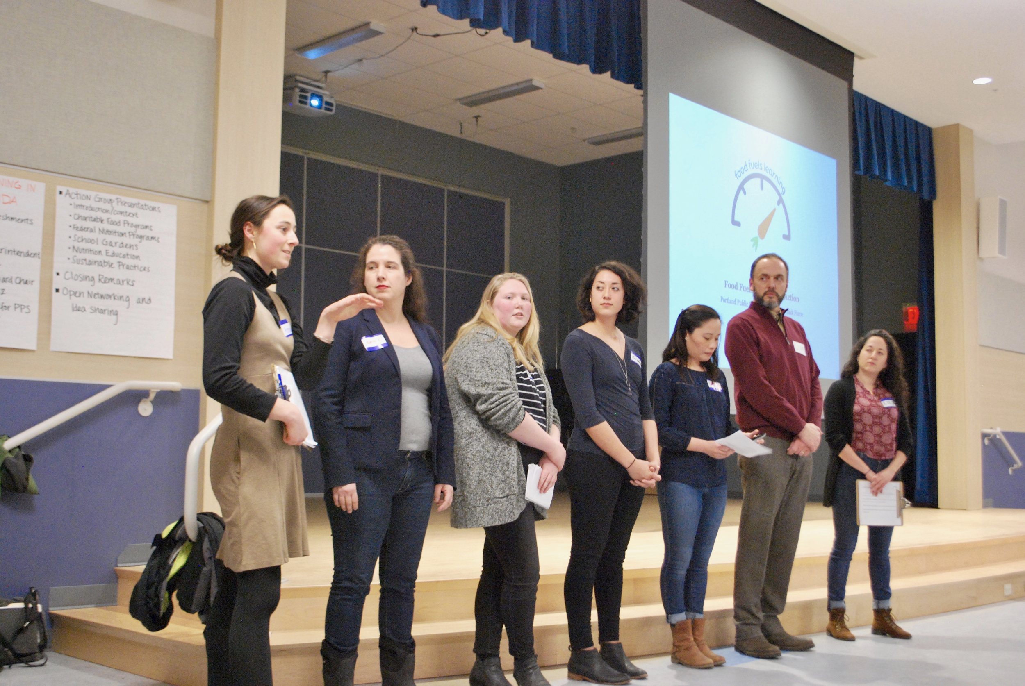
Leadership Team (1)
Notes:
Jim

Slide 14
Leadership Team (2)
Submitted Gamechangers Laboratory & THRIVE 2027 grants
Published Food Fuels Learning Toolkit: Conducting an Assessment of School System Food Security
Presented at Universities Fighting World Hunger and Farm to Institution New England Summit, will present at ME Farm to School Conference
Presented testimony in Augusta in support of relevant child nutrition policies
Rebranded from PPS Food Security Task Force to Food Fuels Learning
Launched new website (foodfuelslearning.org) and facebook page (facebook.com/foodfuelslearning)
Creating Food Fuels Learning Listserv
Notes:
Jim

Slide 15
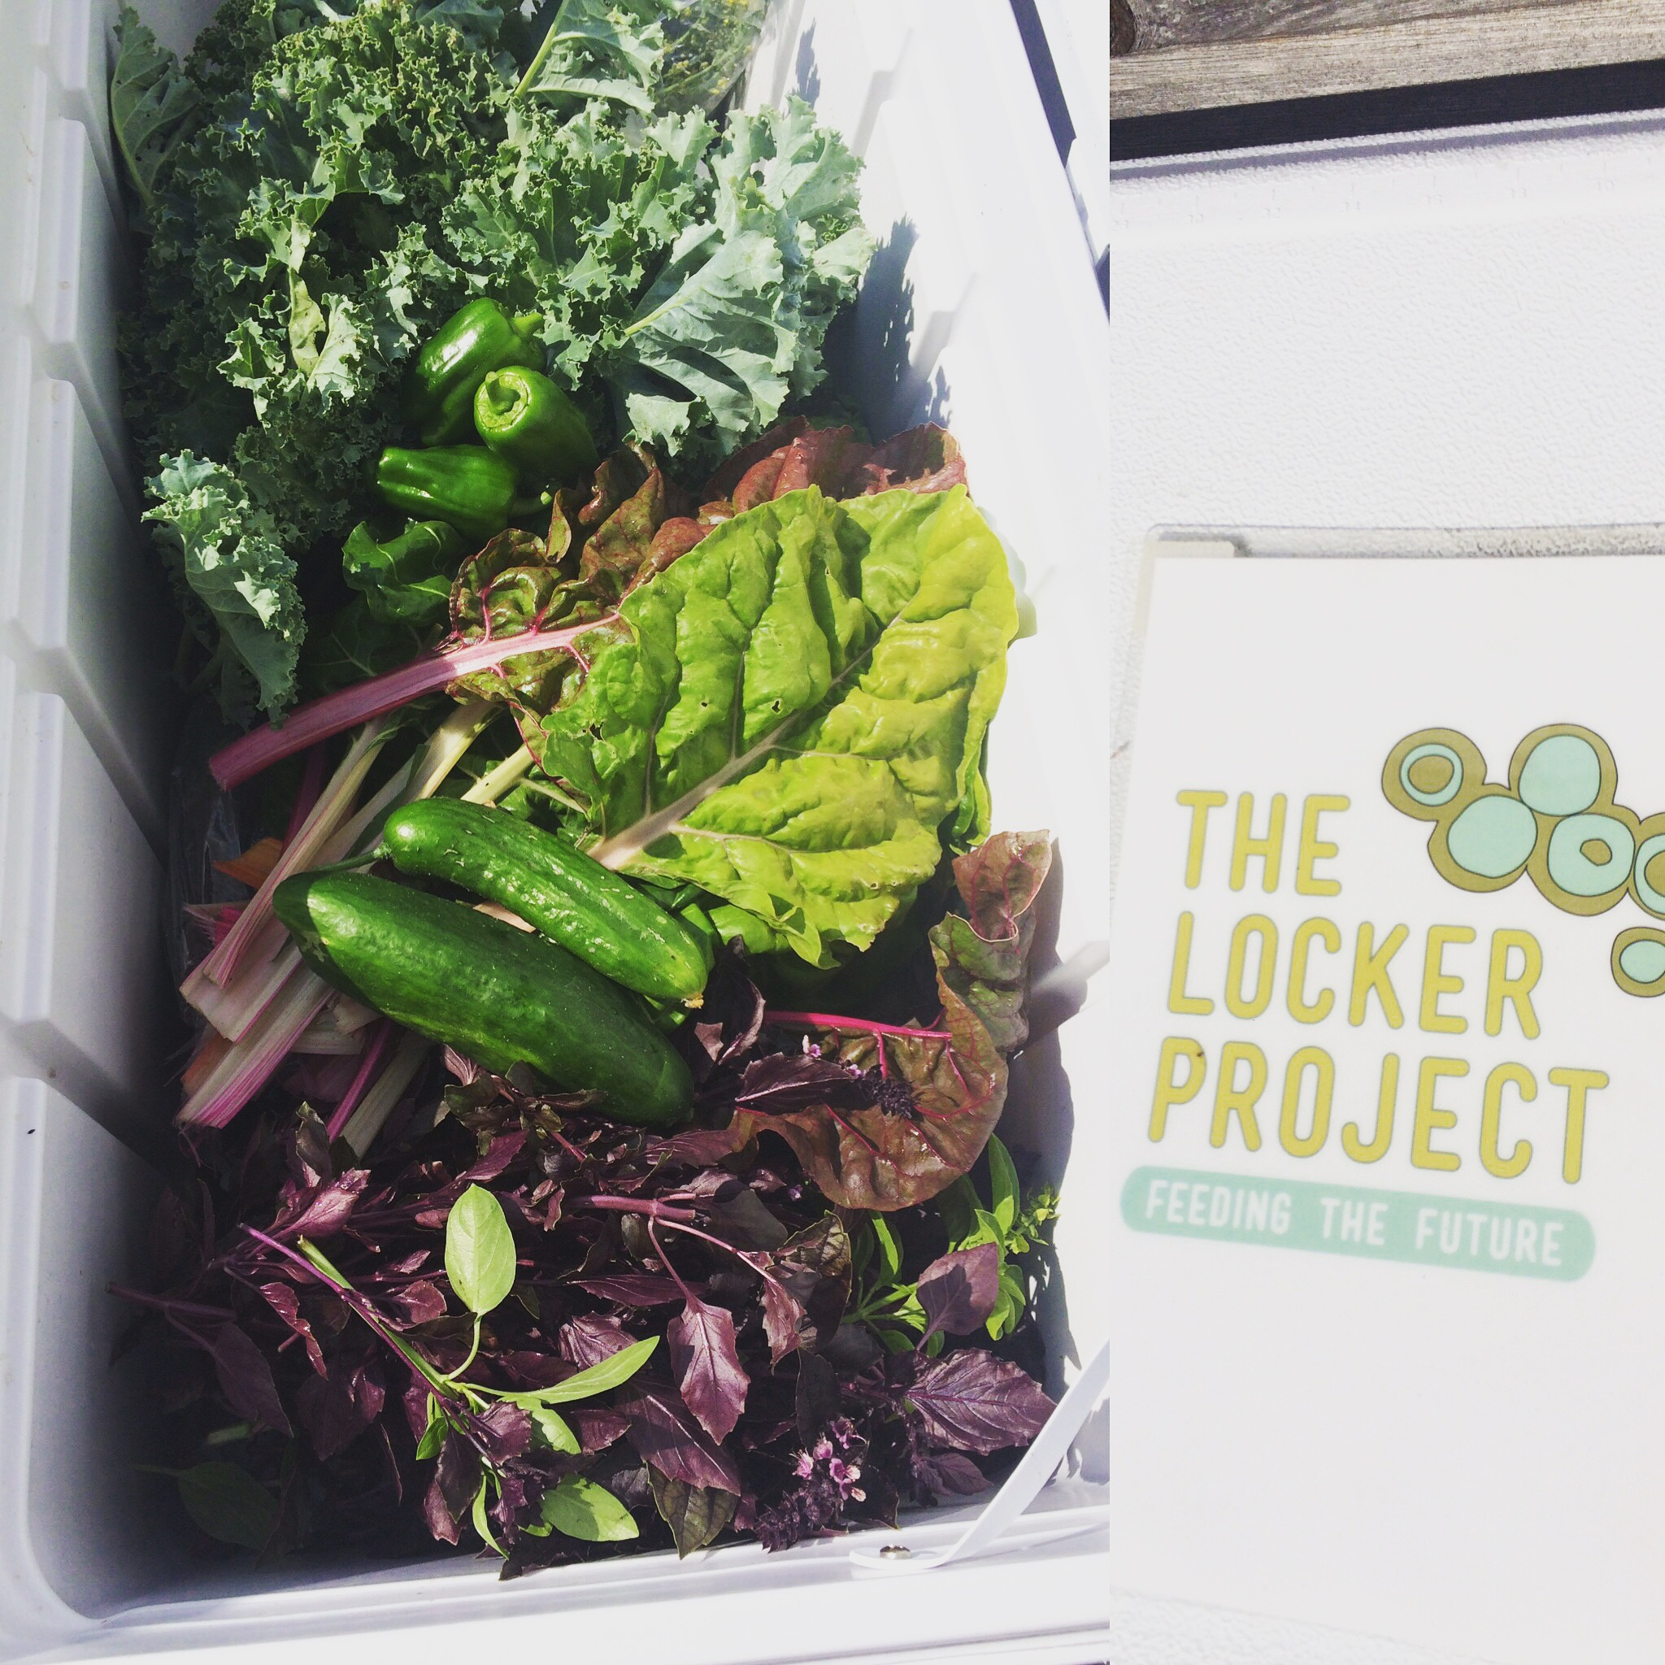
Charitable Food Programs (1)

Slide 16
Charitable Food Programs (2)
Recommendation | Progress | Deadline
1.1 Circulate Portland Community Food Resource Guide and Portland Summer Food Resource Guide to families and all school staff at the beginning and end of the year, respectively | Portland Community Summer Food Resource Guide is completed. Circulation will occur in paper form to all elementary schools and will be available on school and district websites | Completed/Ongoing
1.5 Strengthen communication and collaboration among organizational partners and liaisons managing charitable food programs | Use Food Fuels Learning website and Facebook page as platform to increase charitable foods program communication PPS Food Security listserv in development | Ongoing Ongoing
2.1 Ensure that there are adequate school liaisons (e.g., staff, volunteers) to manage the charitable food programs at the schools and to maintain adequate food supply | Complete school site visits to identify what each school charitable food program needs for support Draft of expectations for school involvement has been developed Designate charitable food program liaison staff position so that there is a point of contact within each school to ensure charitable food program sustainability | Two schools completed; Ongoing Completed April 2019 Ongoing
3.1 Partner organizations collaborate with schools that do not have an existing charitable food program to prioritize what would serve their school best | Two schools identified and charitable food programs in development | Ongoing

Slide 17
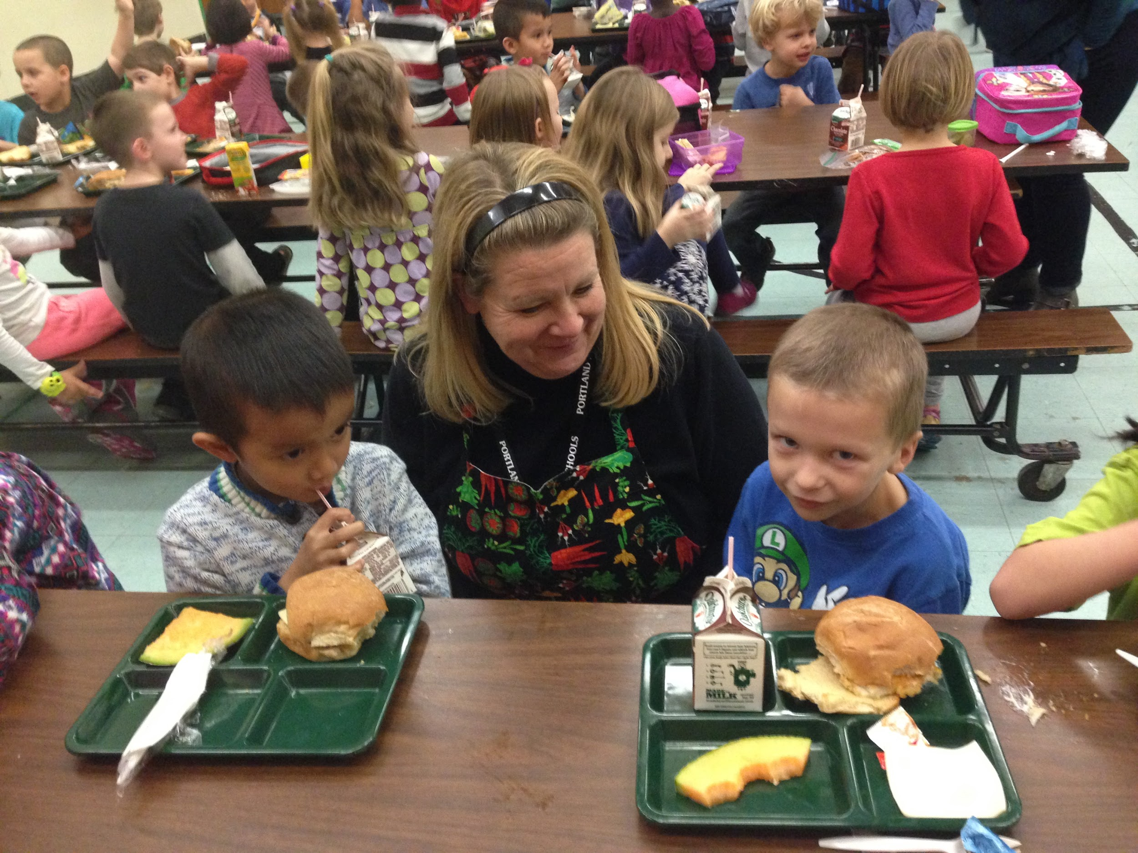
Federal Nutrition Programs (1)

Slide 18
Federal Nutrition Programs (2)
Recommendation | Progress | Deadline
1.2 Collect, analyze, and incorporate student feedback on menu options through districtwide taste tests and response forms | Cultivating Community/FoodCorps taste tests Analyzing production sheet data | Quarterly throughout school year September 2019 (Data aggregation began July 2019)
1.5 Develop a summer meals strategic plan that includes monthly stakeholder meetings beginning in February | Monthly meetings with great community participation Developed a new summer meals map | June -August 2019 Completed June 2019
3.4 Exceed federal nutritional requirements by focusing on nutrient dense, minimally processed foods | Scratch made: chili, marinara sauce, mashed potatoes, hummus Testing overnight oatmeal Harvest of the Month Program Daily hot vegan lunch option | Currently serving Ongoing Fall 2019 September roll out

Slide 19
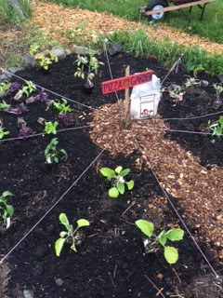
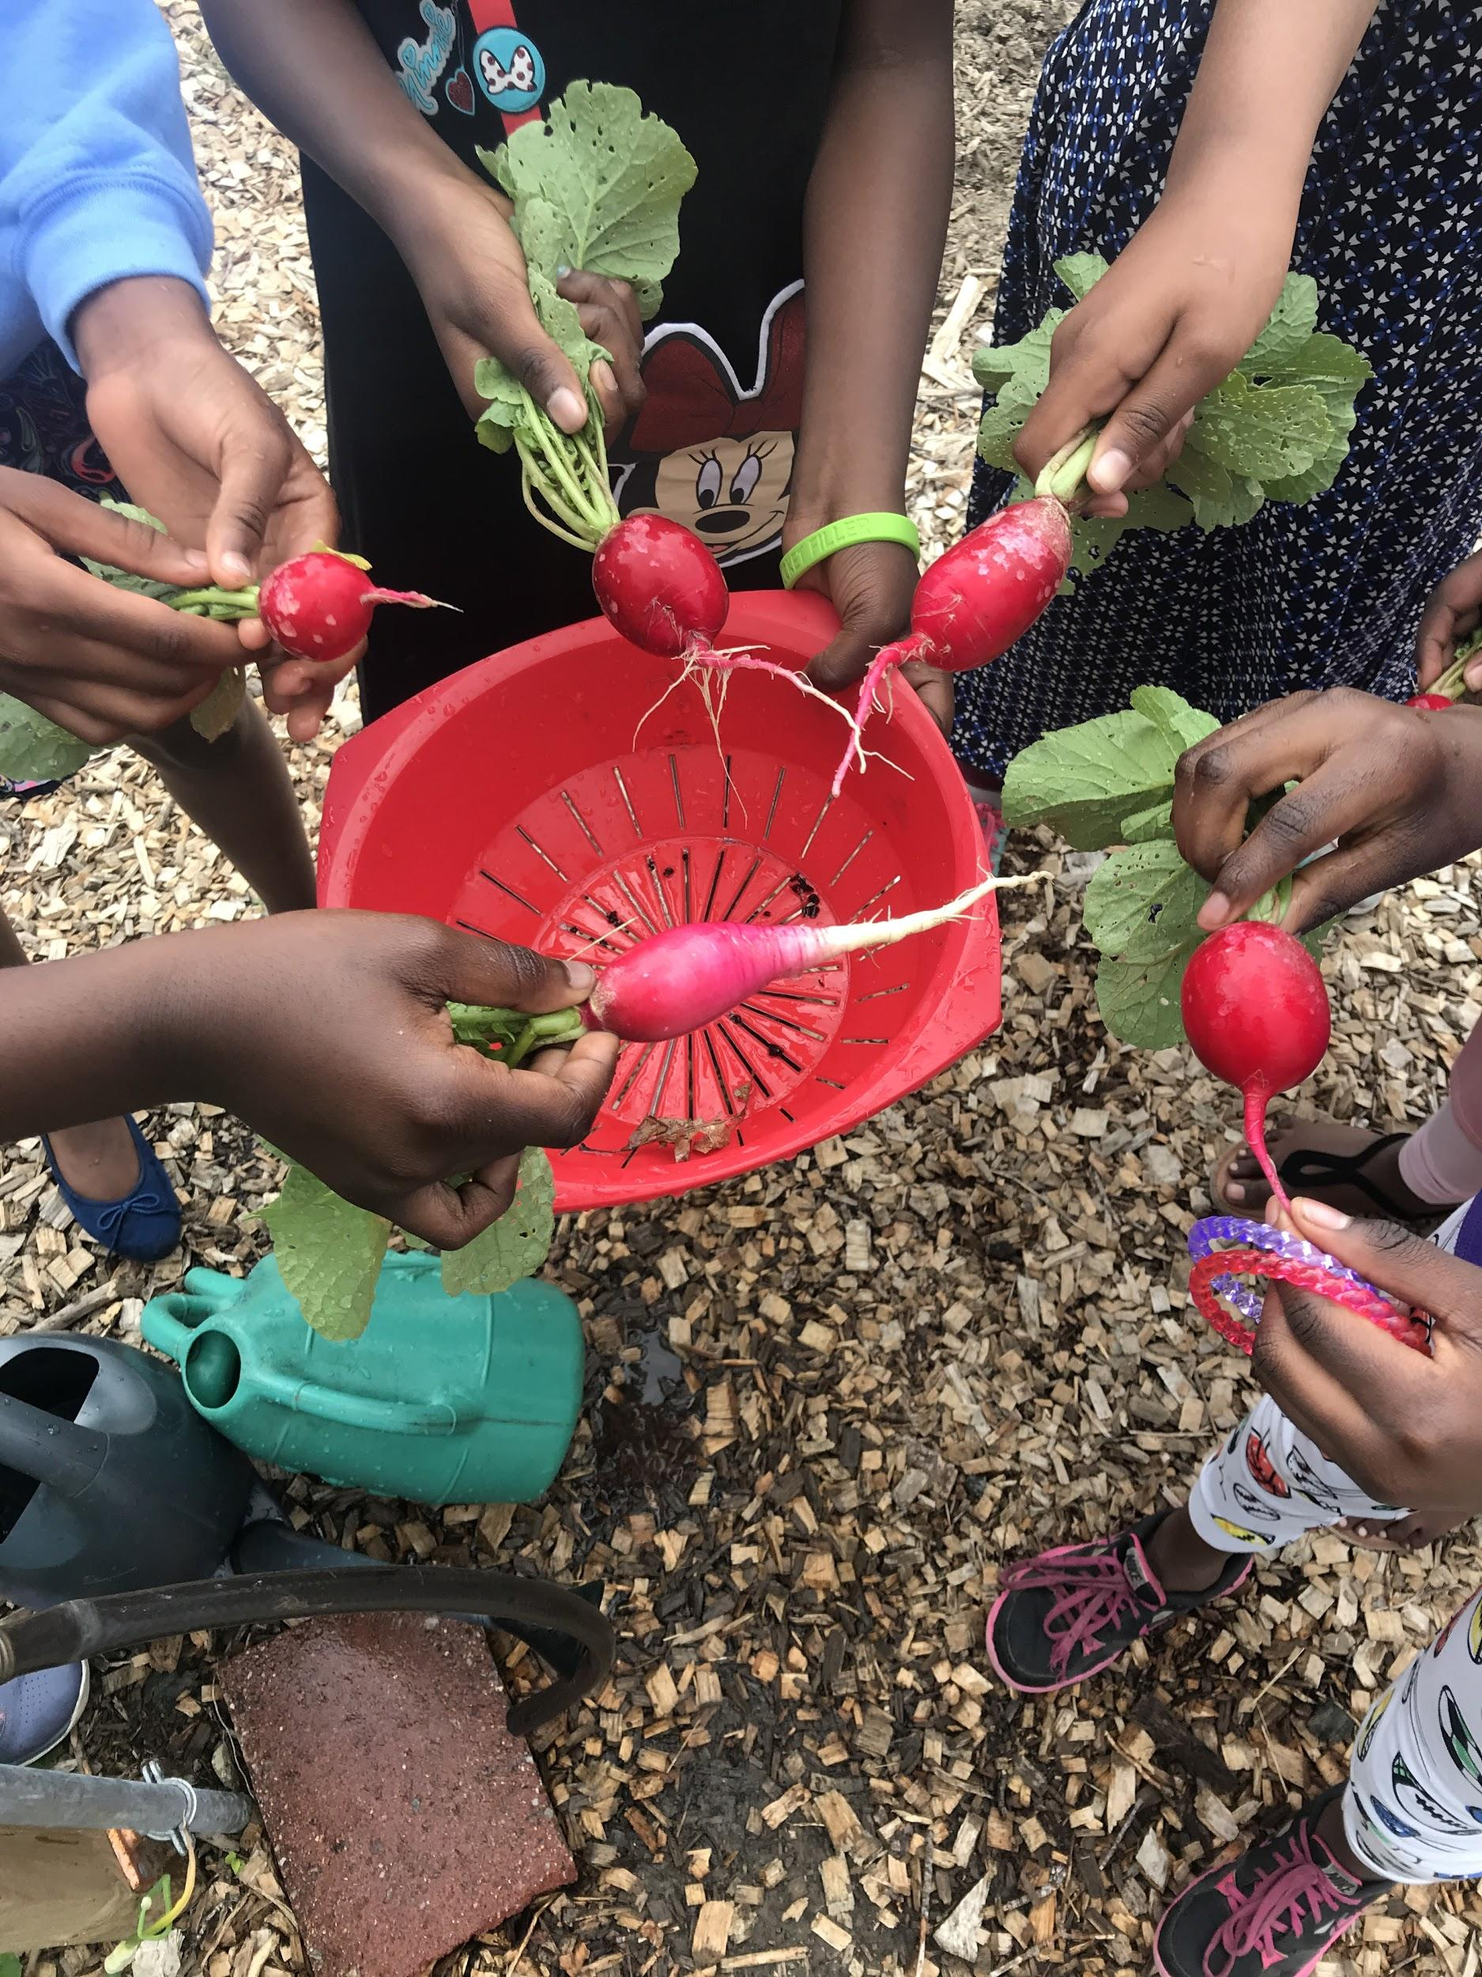
School Gardens (1)

Slide 20
School Gardens (2)
Recommendation | Progress | Deadline
2.2 Convene in-person quarterly meetings | Hold monthly meetings, rotating host and school garden program that is highlighted | 9 schools and 1 non-profit have hosted meetings 65 people have attended meetings 10 schools are actively involved
3.3 Provide stipends to school garden coordinators | Developed School Garden Coach Model for PPS Defined budget of $32,500 to support 13 schools with garden programs to implement garden coach model Some schools are instating the model as possible for 2019-2020 school year (Rowe, Riverton) | Developed for April Quarterly Meeting Funding goal is for 2020-2021 school year
2 Create a district-wide School Garden Network | Host a celebratory and engaging PPS School Garden Tour | This August, Sunday the 25th from 1:00pm-5:00pm!

Slide 21
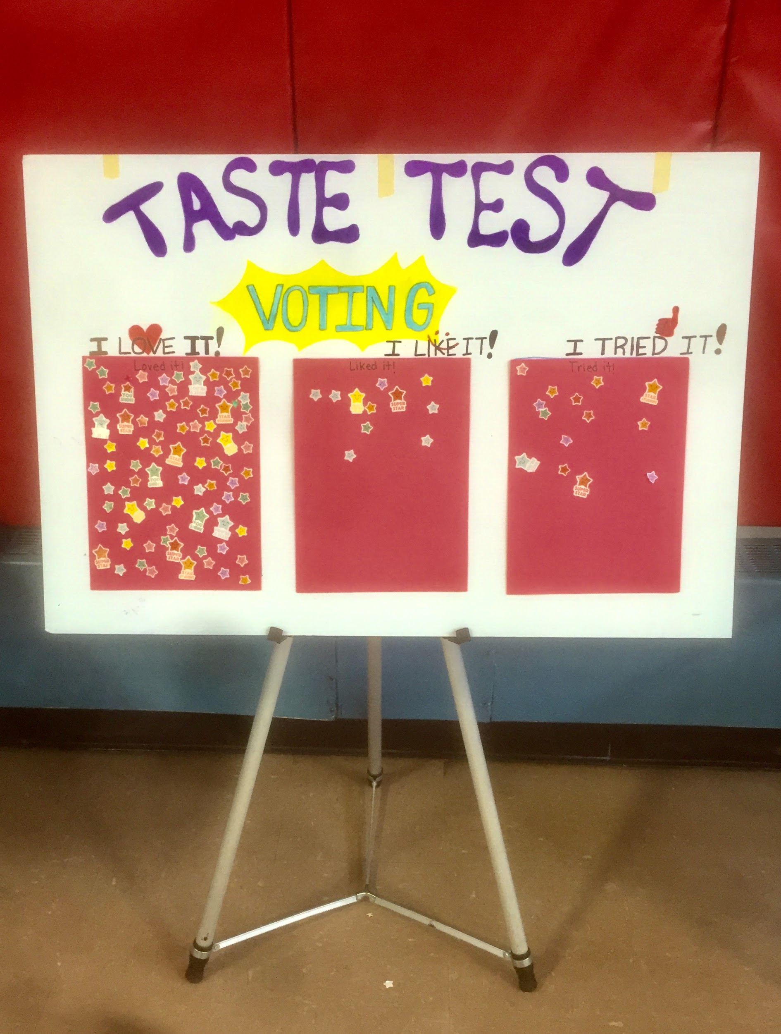
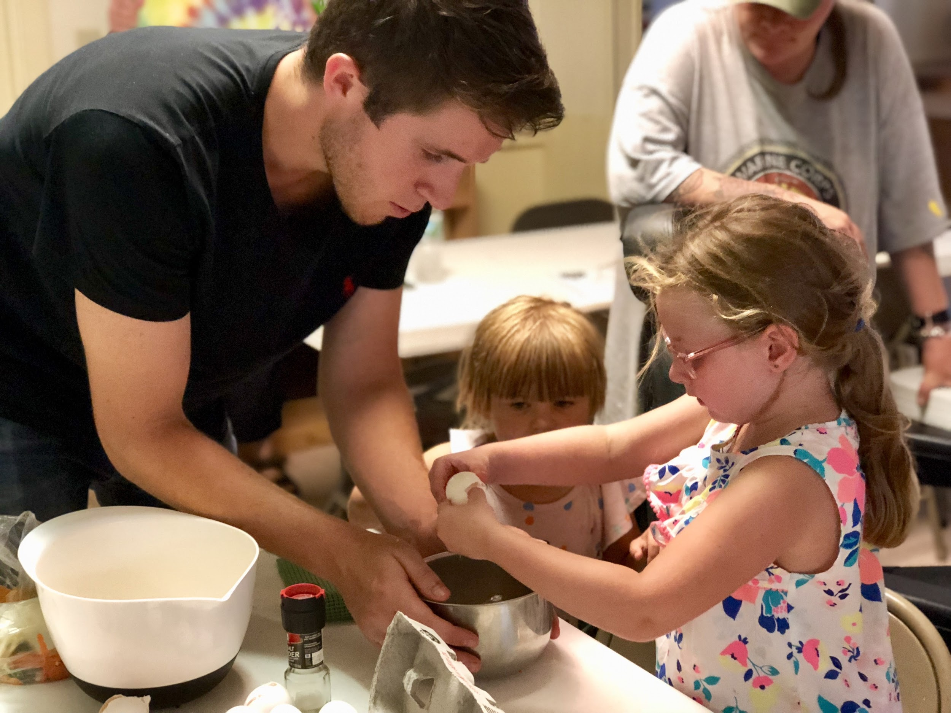
Nutrition Education (1)

Slide 22
Nutrition Education (2)
Recommendation | Progress | Deadline
2.1 Coordinate existing nutrition education efforts by partner organizations, eliminating redundancies and increasing reach | Creating comprehensive Nutrition Education Map with partner organizations and school staff teaching nutrition ed Creating and administered school staff survey Generated Nutrition Survey Report Strategize around how to encourage eligible elementary school teachers to opt-in to free nutrition education from nonprofit service providers | Began March 2019, ongoing May 2019 July 2019 July 2019
3.1 Equip schools with the basic infrastructure to teach nutrition education | Group explores option of “nutrition education carts” with cooking resources that teachers or program staff could check out of the library Partner organizations share out what they bring with them for classes and approximate costs Draft estimate of how much one “nutrition education cart” will cost | 1,2,3) May 7th
3.3 Foster greater awareness of available nutrition programs, and strengthen student and family participation | Partner organizations share about what they offer and which schools they are eligible to work in Connecting high school principals with EFNEP service providers | March 2019 June 2019

Slide 23
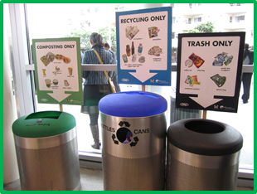
Sustainable Practices (1)

Slide 24
Sustainable Practices (2)
Recommendation | Progress | Deadline
2.1 Involve custodial and lunchroom staff in trainings and discussions | Meet with head custodians at their monthly meeting to explain what we are doing and ask for their feedback. Create a PPS composting / recycling guide to inform schools about best practices and the successes of other schools in the district | Custodial meeting: August 23rd Began June 2019, ongoing
2.3 Incorporate composting into education goals, and involve students in composting | Visit each school to understand the barriers with each composting and recycling program Create a PPS composting / recycling guide to inform schools about best practices and the successes of other schools in the district | Completed site visits in May 2019 Began June 2019, ongoing
3.0 Institute sustainable practices in cafeteria purchases and operations | Work with Rowe Elementary School to eliminate plastic cutlery in their cafeteria and replace it with reusable cutlery Research alternative ways to dispose of a cafeteria lunch container that is not compostable or recyclable | Ongoing Ongoing
Notes:
My name is Colleen Donlan (I am a former PPS student and the Local Food Coordinator VISTA with the Cumberland County Food Security Council) and I convene the Sustainable Practices Action Group. Our action group includes representation from We Compost It!, Natural Resource Council of Maine, NE Environmental Finance Center, Foodcorps, facilities staff, teachers, parents, and community members. This past spring we visit each school to discuss challenges and successes of the cafeteria waste separation program with custodians, food service staff, green team representation, teachers, administrators and students. We are now created a best practices guide from the information we collected through those visit visits. We are attending a custodial meeting with month to gain feedback to include in the guide as well. We hope the guide will eliminate confusion around composting and recycling, allow for more resource sharing between schools, and clarify district wide standards for cafeteria separation.
We are also working on updating the 2012 Sustainability Policy to include more details around…

Slide 25
Food Fuels Learning Asks/Requests

Slide 26
Food Fuels Learning Asks/Requests
Asks/Requests
Attend upcoming events: School Garden Tour (August 25th, 1-5pm, Start at East End Community School) Food Fuels Learning Community Celebration (September 16th, 6-7:30pm, Riverton Elementary)
Publicize the PPS Food Fund
Share Food Fuels Learning with your networks
Encourage the community to eat school meals
Advocate for these in the school budget: Positions that increase capacity of Central Kitchen School Garden Coaches District Wellness Coordinator

Slide 27
Any questions?

Slide 28
To learn more:
www.foodfuelslearning.org
www.facebook.com/foodfuelslearning

Slide 29
Back-up slides

Slide 30
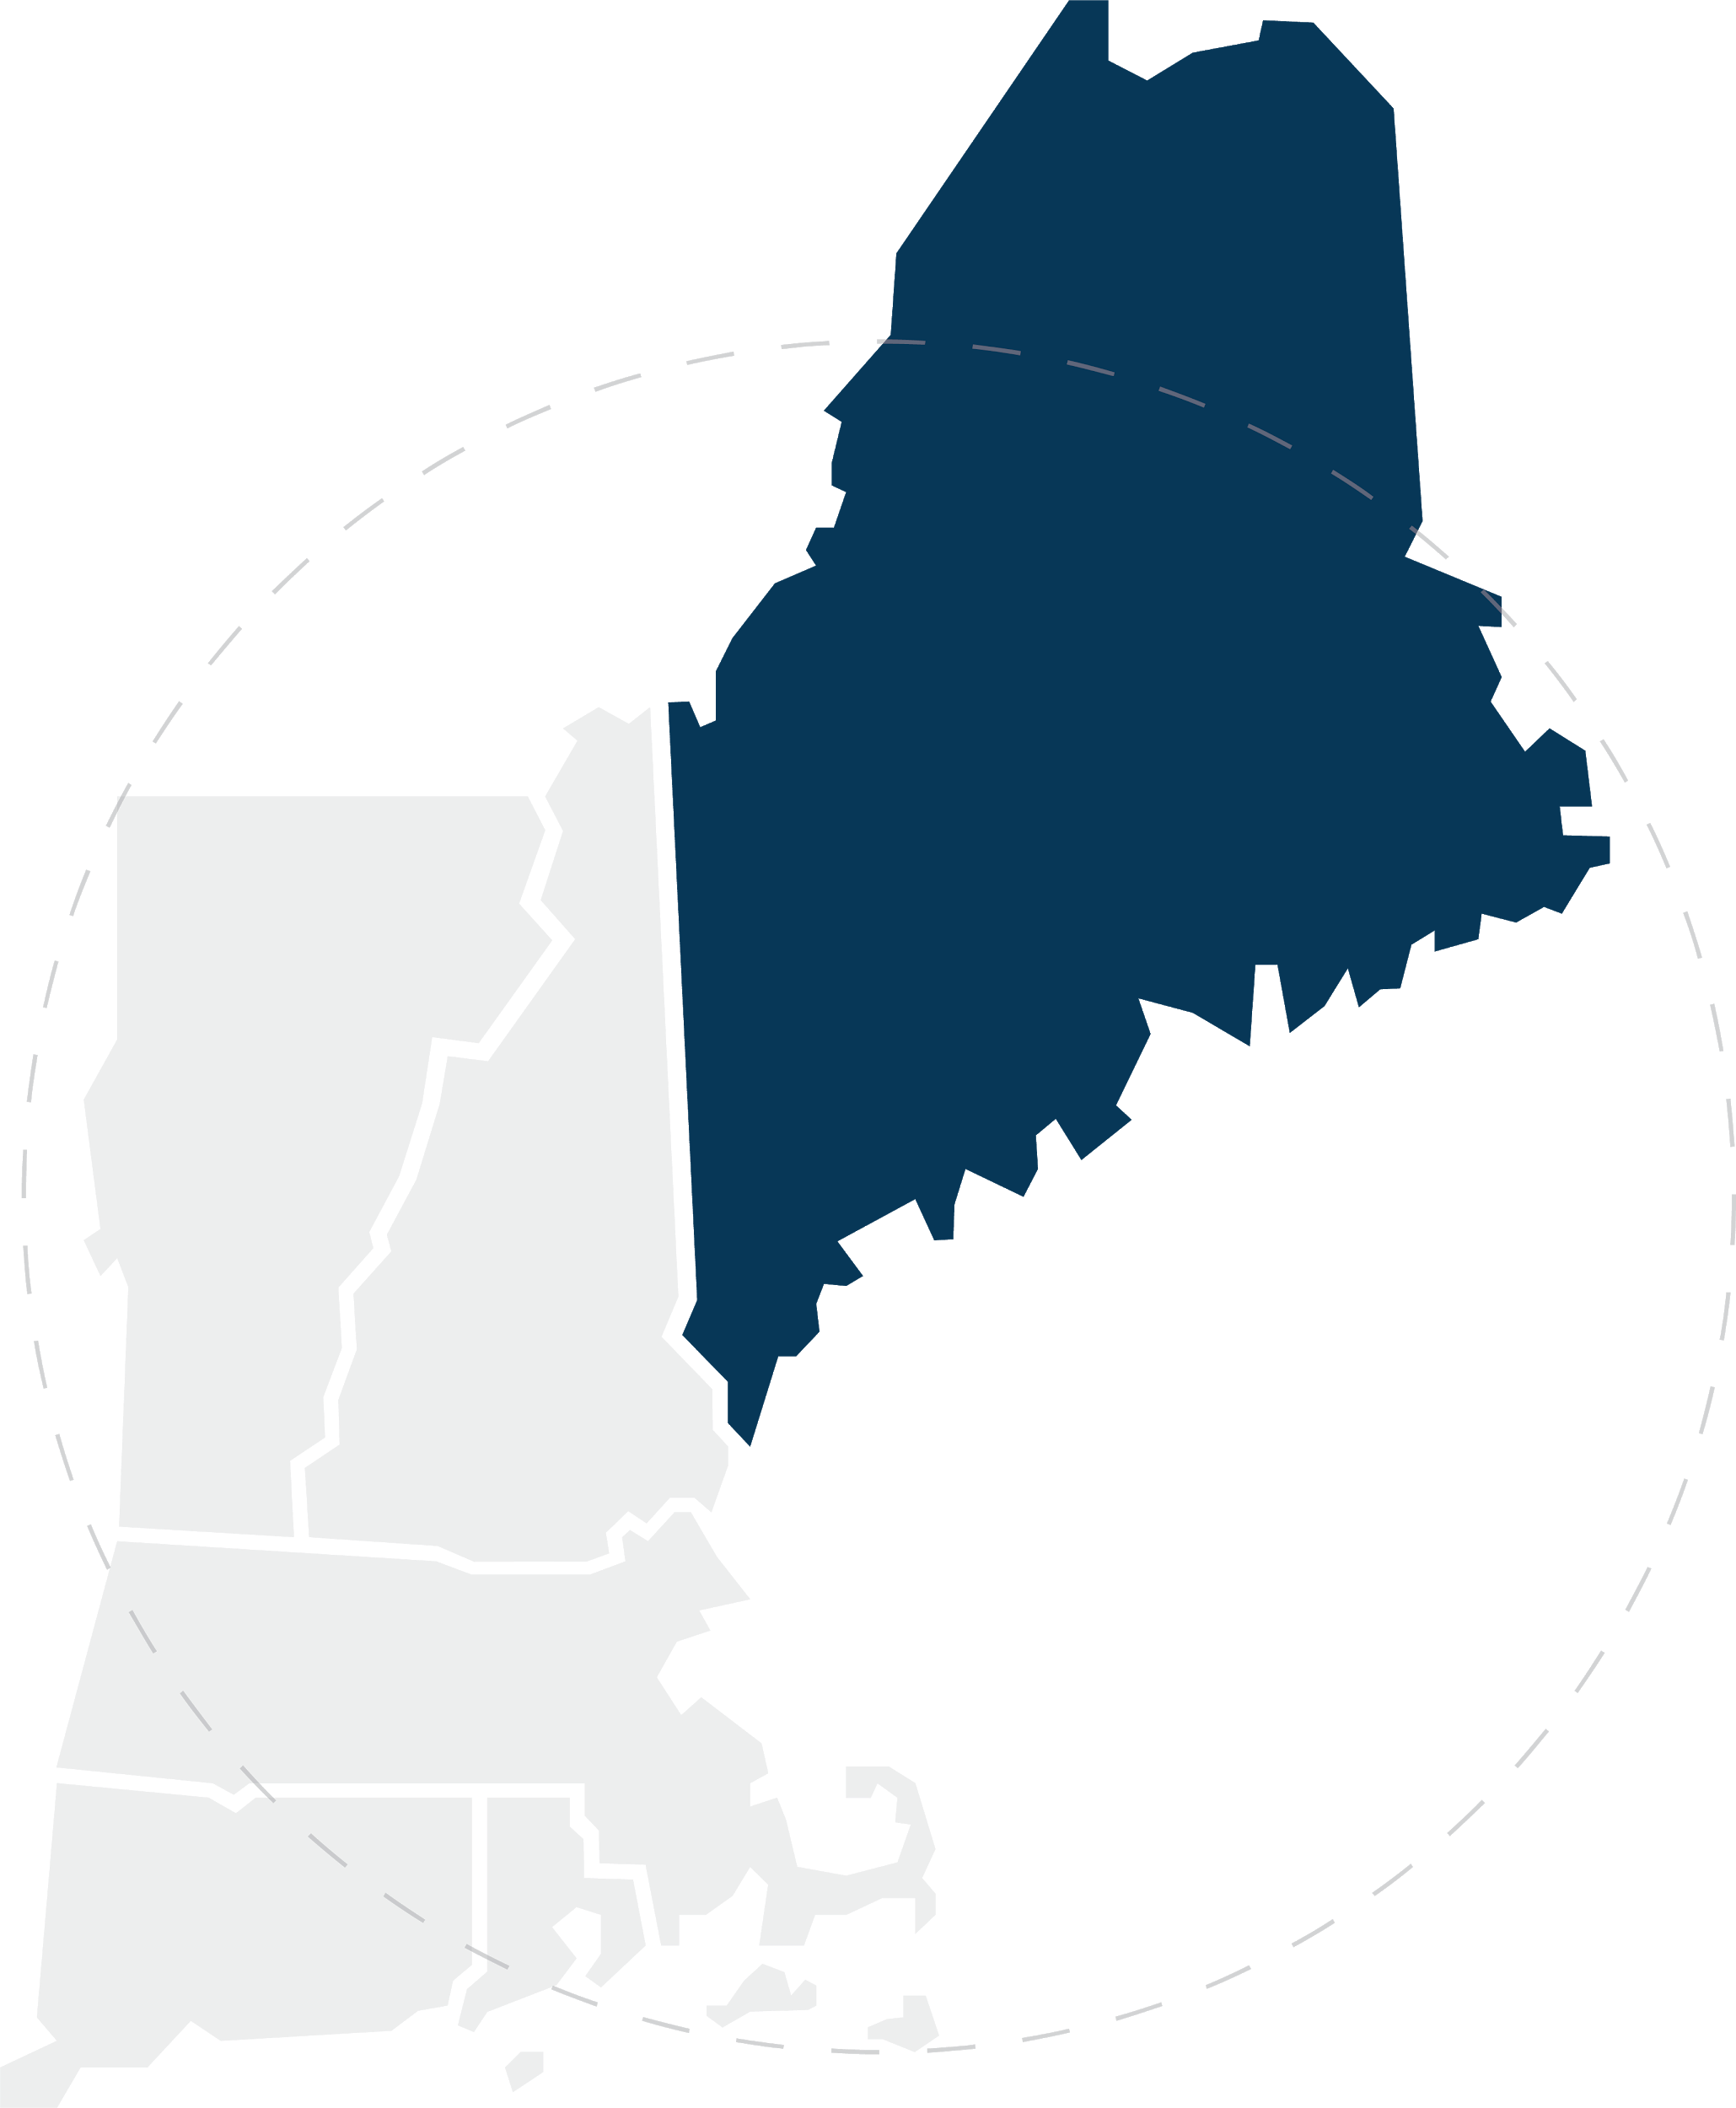
Recommendations District-wide (1)
District Recommendation 1 - Develop and implement district-wide and school-specific strategic plans based on the PPS Food Security Needs Assessment:
Develop and implement food security strategic plans that align with the PPS District Wellness Plan and Portland Promise through collaboration with PPS District Wellness Committee, schools, and partner organizations
Use the Portland Education Foundation; Full Plates Full Potential; Farm to School grants; and other funding opportunities to support the implementation of PPS Food Security Needs Assessment recommendations

Slide 31
Recommendations District-wide (2)
District Recommendation 2 - Develop a yearly monitoring and evaluation plan to track progress implementing the district-wide and school-specific strategic plans:
Develop shared indicators for schools and partner organizations for data collection and tracking
Institutionalize data collection and data sharing practices
Report on yearly findings at the end of each school year
Build upon PPS food system successes in subsequent years’ strategic, monitoring and evaluation plans

Slide 32
Recommendations District-wide (3)
District Recommendation 3 - Institutionalize and maintain a PPS Wellness Coordinator position whose responsibilities include acting as food security advocate on the PPS District Wellness Committee, as follows:
Coordinate food security efforts by partner organizations and schools; eliminate redundancies, increase reach, oversee networks and resource sharing, and ensure equitable access to food security resources across the district
Participate on the PPS District Wellness Committee and in development and implementation of district-wide and school-specific strategic plans
Participate in development of school-based wellness teams
Identify and research potential funding sources for the implementation of district-wide and school-specific strategic plans
Provide professional development training and learning opportunities for school staff on poverty and food security
Create and implement an outreach plan to increase awareness of student food insecurity and promote available food security resources through district-organized events

Slide 33
Recommendations District-wide (4)
District Recommendation 4 - Designate one or more “food security champions” on each school Wellness Team, with responsibilities as follows:
Serve as liaison between the appropriate school staff members and partner organizations with regards to food security programming
Participate in development and implementation of district-wide and school-specific food security strategic plan
Oversee monitoring and evaluation of food security programming at their school
Report to PPS Wellness Coordinator on District Wellness Committee

Slide 34
Recommendations Charitable food programs
Charitable Foods Recommendation 1 - Enhance consistent resource-sharing within, and among, school communities
1.1 Circulate Portland Community Food Resource Guide (Appendix A) and Portland Community Summer Food Resource Guide (Appendix B) to families and all school staff at the beginning and end of the school year, respectively
1.2 Incorporate charitable food program information into trainings for school staff. All staff should be informed on what resources are available, trauma-informed ways to help families access services, and the appropriate contact people
1.3 Distribute a general information packet and food security survey at the beginning of each school year to determine wants and needs and enable families to opt in to programs
1.4 Send home feedback forms through backpack programs to improve communication with families receiving this service
1.5 Strengthen communication and collaboration among organizational partners and liaisons managing charitable food programs
1.6 Form charitable foods provider PPS network to share resources and best-practices developed at each school

Slide 35
Recommendations Charitable food programs
Charitable Foods Recommendation 2 - Improve the reliability, efficiency, and sustainability of charitable food programs
2.1 Ensure that there are adequate school liaisons (e.g., staff, volunteers) to manage the food programs at the schools and to maintain adequate food supply
2.2 Guarantee stipends for the school liaisons managing charitable food programs
2.3 Invest in necessary infrastructure (e.g., cold storage and equipment)

Slide 36
Recommendations Charitable food programs
Charitable Foods Recommendation 3 - Encourage low-barrier access and high availability of school pantries and food options
3.1 Partner organizations collaborate with schools that do not have an existing charitable food program to prioritize what would serve their school best
3.2 Increase communication about charitable food opportunities at each school to students and families
3.3 Require no paperwork or eligibility checks for access
3.4 Work with partner organizations to offer free, nutritious food in more places (e.g., bowls of fruit in the classroom, Adult Ed, multicultural office)
3.5 Engage with partner organizations to increase the availability of fresh produce and of culturally appropriate foods such as labeled halal options

Slide 37
Recommendations Federal nutrition programs
Federal Nutrition Programs Recommendation 1 - Increase overall student participation in federal nutrition programs
1.1 Launch a professional school meals marketing campaign to attract more students and families
1.2 Collect, analyze, and incorporate student feedback on menu options through district-wide taste tests and response forms
1.3 Maximize cafeteria and lunch period efficiency to ensure students have sufficient time to enjoy and digest their food
1.4 Support and evaluate Child and Adult Care Feeding Program (CACFP) 2018 meal pilot and maximize this program throughout district
1.5 Develop a summer meals strategic plan that includes monthly stakeholder meetings beginning in January

Slide 38
Recommendations Federal nutrition programs
Federal Nutrition Programs Recommendation 2 - Encourage full participation of all eligible students in free and reduced-price meals
2.1 Continue to encourage and incentivize registration of all eligible families for free and reduced-price meals
2.2 Continue to support families completing eligibility paperwork and implement additional best practices
2.3 Fully implement the Community Eligibility Provision (CEP) in every eligible school
2.4 Train staff on how to manage breakfast in the classroom to ensure maximum reimbursement

Slide 39
Recommendations Federal nutrition programs
Federal Nutrition Programs Recommendation 3 - Cultivate a school culture of healthy and inclusive food practices
3.1 Serve more meals, snacks, and taste tests that represent and celebrate the cultural diversity of the student body
3.2 Restore school budget line item that subsidizes food service, especially local food procurement
3.3 Increase capacity for food preparation to include more scratch cooking
3.4 Exceed federal nutritional requirements by focusing on nutrient dense, minimally processed foods
3.5 Limit access to unhealthy food options outside reimbursable school meals as specified in the District Wellness Policy and Smart Snacks regulations

Slide 40
Recommendations School gardens
School Gardens Recommendation 1 - Develop and implement school garden–based learning goals integrated with Common Core State Standards
1.1 Establish a school garden at every school
1.2 Institute teacher training on garden-based education as Continuing Education Unit (CEU) credit
1.3 Provide all teachers with a garden curriculum formulated from existing Maine-based lessons connected to Common Core State Standards
1.4 Maintain a resource list of existing curricula for teachers to draw from to connect to their learning goals
1.5 Increase garden-related summer programming for students that includes hands-on learning and maintenance

Slide 41
Recommendations School gardens
School Gardens Recommendation 2 - Create a district-wide School Garden Network
2.1 Establish a platform to share resources, grants, tips, and ask questions
2.2 Convene in-person quarterly meetings
2.3 Maintain an online presence to promote school gardens in the district and recruit interested volunteers from the community
2.4 Increase efficiency of produce distribution between school garden coordinators and liaisons managing charitable food programs during the growing season
2.5 Raise awareness of and fully utilize garden-based education resources in the state

Slide 42
Recommendations School gardens
School Gardens Recommendation 3 - Increase funding and infrastructure for school garden programs
3.1 Identify and utilize sources of funding for school garden maintenance and programming for all schools
3.2 Designate budget line in Parks & Recreation Department to support outdoor learning spaces on school property
3.3 Provide stipends to school garden coordinators
3.4 Create school garden committees at each school with representatives from the school administration, each grade, and the parent community to institutionalize gardening into school culture
3.5 Organize more and more-sustained support for summer maintenance

Slide 43
Recommendations Nutrition education
Nutrition Education Recommendation 1 - Develop a district-wide comprehensive and equitable approach to nutrition education
1.1 Establish nutrition education goals for each grade that build upon the previous year’s lessons
1.2 Create and implement a nutrition education curriculum aligned with Common Core State Standards through collaboration with the academic departments and organizational partners

Slide 44
Recommendations Nutrition education
Nutrition Education Recommendation 2 - Designate one person to oversee nutrition education in the district, with responsibilities as follows
2.1 Coordinate existing nutrition education efforts by partner organizations, eliminating redundancies and increasing reach
2.2 Provide resources and training to teachers on how to teach basic nutrition education
2.3 Leverage funding opportunities among the district and partner organizations by collaborating on grant proposals
2.4 Convene bi-annual meetings among partner organizations

Slide 45
Recommendations Nutrition education
Nutrition Education Recommendation 3 - Prioritize and implement nutrition education in schools
3.1 Equip schools with the basic infrastructure to teach nutrition education
3.2 Provide a stipend to teachers who provide after-school nutrition programming
3.3 Foster greater awareness of available nutrition programs, and strengthen student and family participation

Slide 46
Recommendations Sustainable practices
Sustainable Practices Recommendation 1 - Develop measurable local food procurement goals for Food Services
1.1 Set local food purchasing goal to at least 20-25% of total food budget
1.2 Launch a marketing campaign to promote local food among the school community
1.3 Prioritize local food procurement from small Maine farms

Slide 47
Recommendations Sustainable practices
Sustainable Practices Recommendation 2 - Follow New England Environmental Finance Center’s ⁵ best management practices for district-wide composting
2.1 Involve custodial and lunchroom staff in trainings and discussions
2.2 Supply school cafeterias with additional composting and waste sorting stations
2.3 Incorporate composting into education goals, and involve students in composting
⁵Sheils, M., & Webster, S. (n.d.). School Cafeteria Recycling & Composting. Retrieved July 28, 2018, from http://neefc.org/index.php/projects/school-cafeteria-recycling-composting.

Slide 48
Recommendations Sustainable practices
Sustainable Practices Recommendation 3 - Institute sustainable practices in cafeteria purchases and operations
3.1 Clarify and institutionalize consistent share table practices
3.2 Purchase compostable or reusable utensils
3.3 Reduce use of single-use plastic by decreasing use of plastic straws and packaged cutlery
3.4 Use pump dispensers instead of individual packets for condiments

